Slide 1
Uosm Robotics Club 2018-2019 Part 2
2nd class of Arduino Module

Slide 2
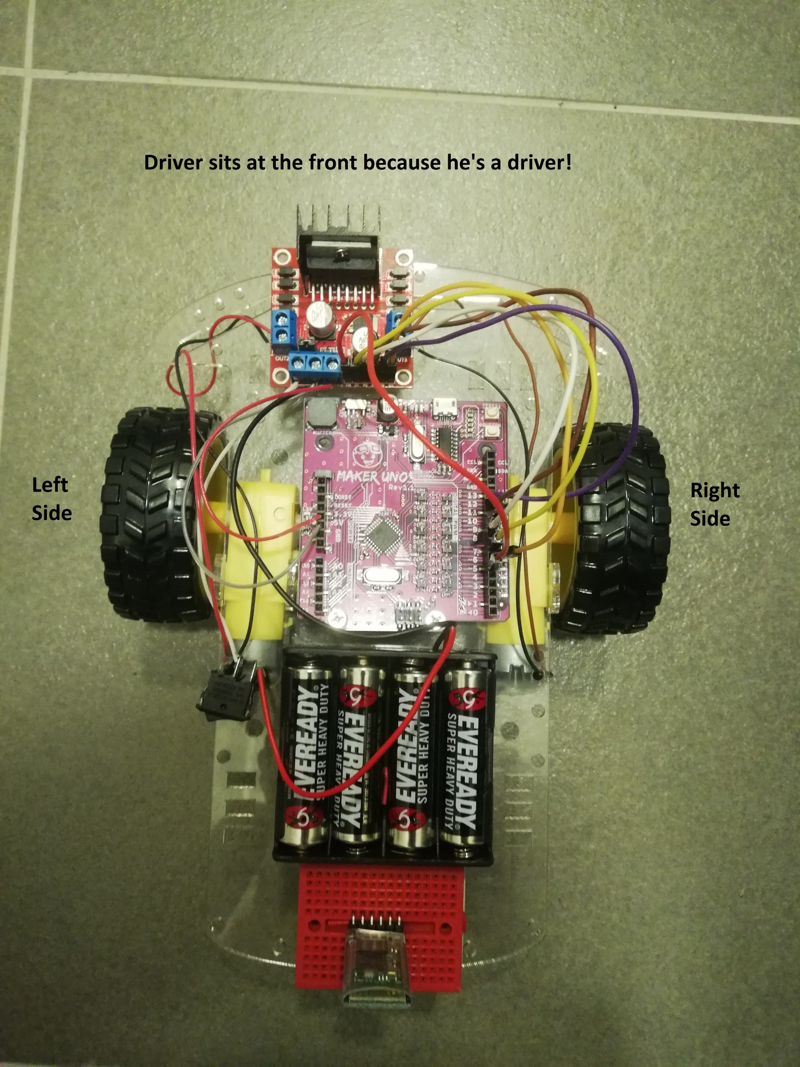

Before wiring the parts…
Motor Driver is the head of the robot. (Important for referencing directions)
Left and Right are referenced according to the Motor Driver location as well.

Slide 3
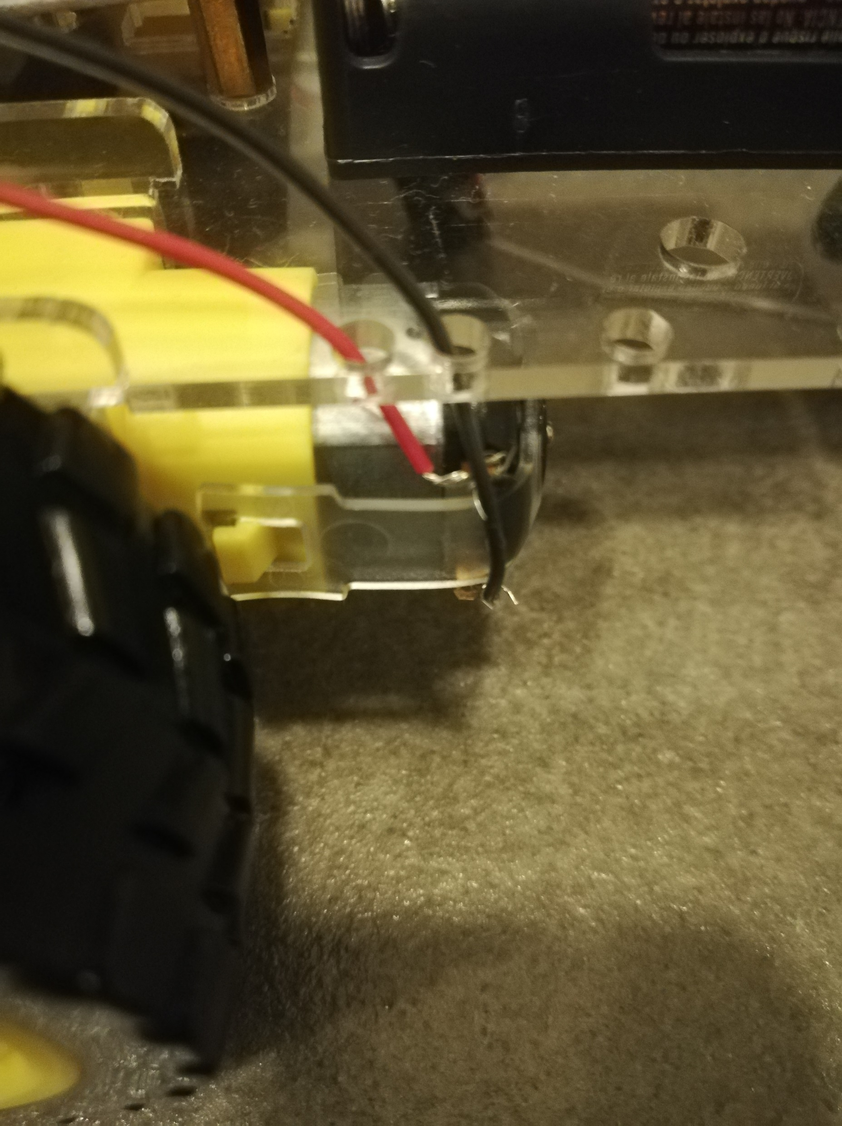
Wiring (warning, do not skip this section)
Step 1:
Get a red and a black wire (long) and connect it to the left motor (tie a knot, beware the handles of the motor as they are very weak and break easily)
Red is hooked at the top, black is hooked at the bottom.

Slide 4
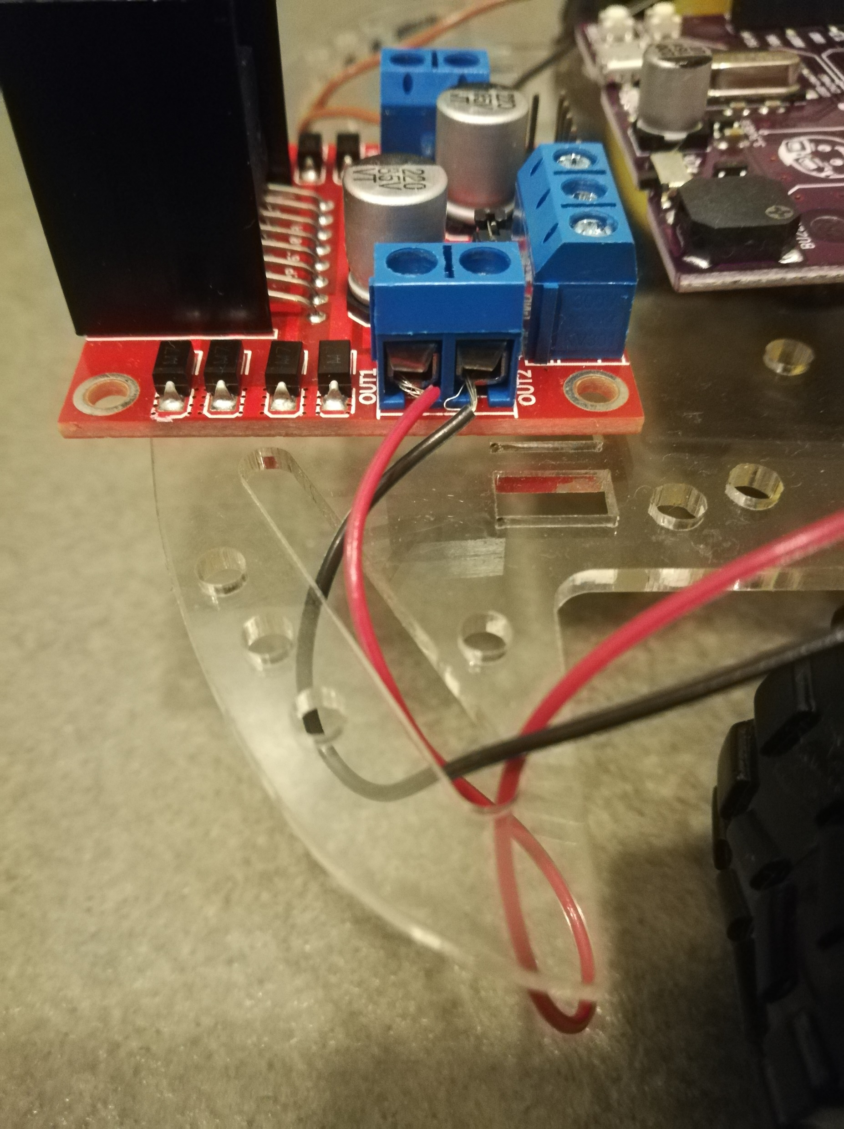
Wiring (MOTOR)
Step 2:
Connect the wires from the motor to the left side of the motor driver
Please pay attention to the terminal connection as it will affect the motor direction.

Slide 5
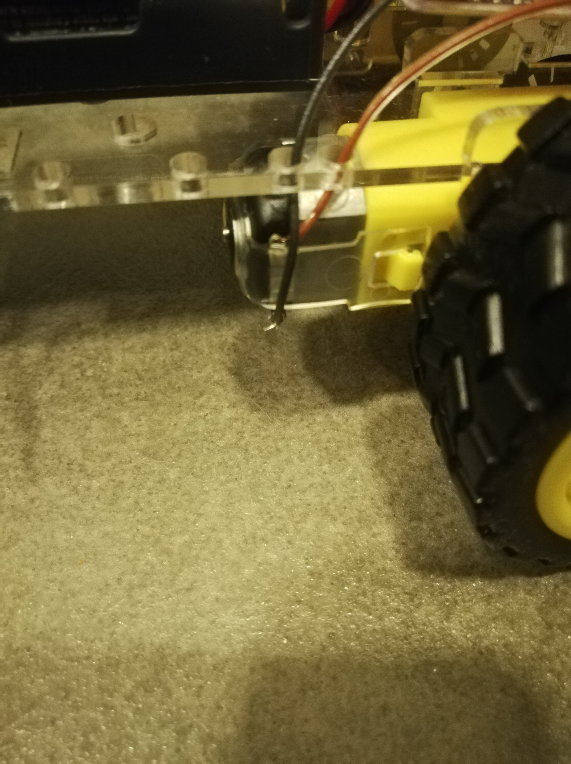
Wiring (MOTOR)
Step 3:
Repeat Step 1 for the right motor as well.
Brown is hooked at the top, black is hooked at the bottom.

Slide 6
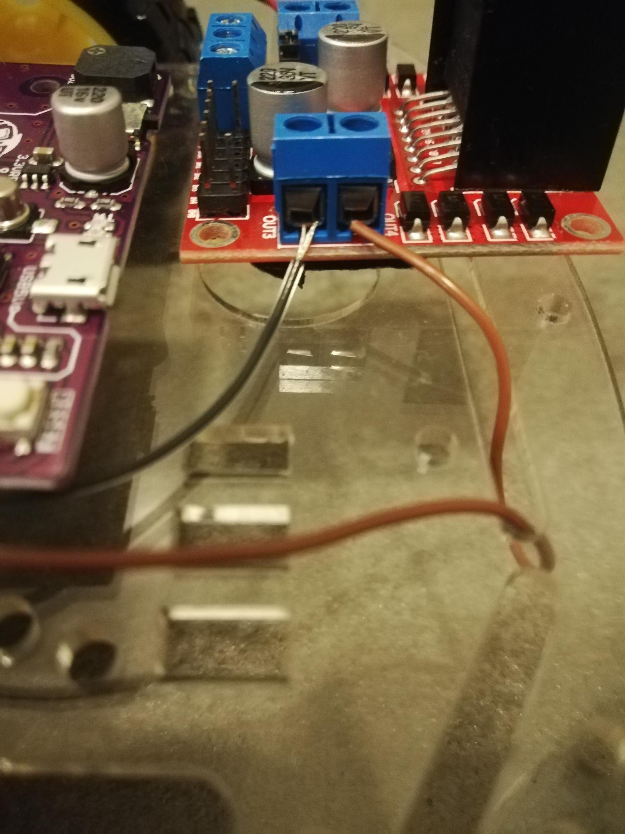
Wiring (MOTOR)
Step 4:
Connect the wires from the motor to the left side of the motor driver
Please pay attention to the terminal connection as it will affect the motor direction.

Slide 7
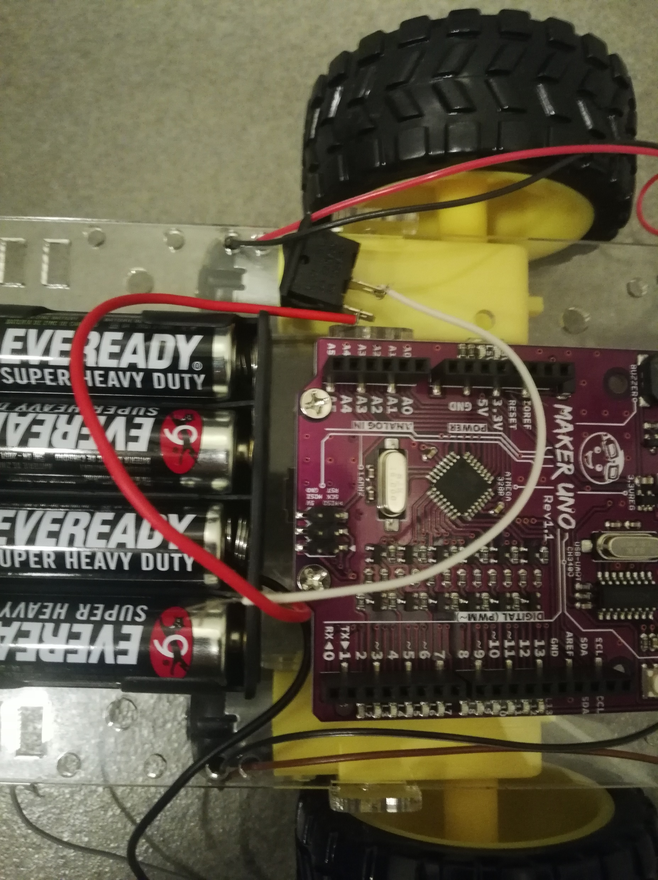
Wiring (SWITCH)
Step 5:
Get a white wire and connect the red wire of the battery holder to the switch. This will act as a power switch for your robot.
The white wire connection will be shown in the next slide, I am just placing it there for fun.

Slide 8
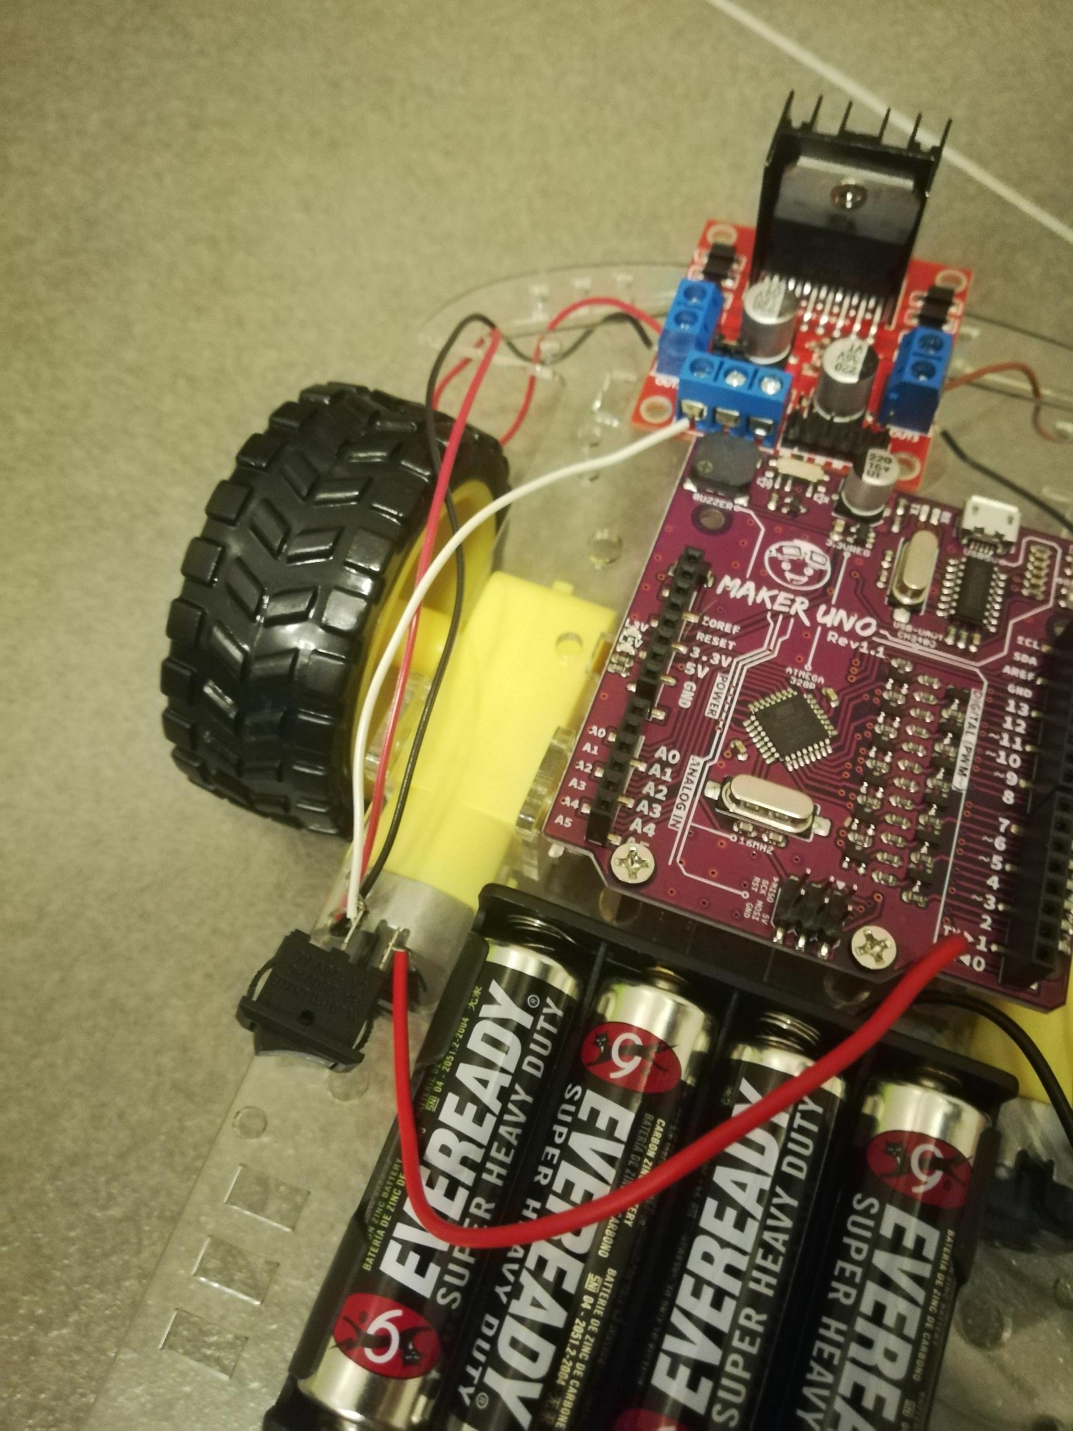
Wiring (SWITCH)
Step 6:
Connect the white wire to the left terminal of the front part motor driver.
The terminal should indicate a +12V sign written on the board.

Slide 9
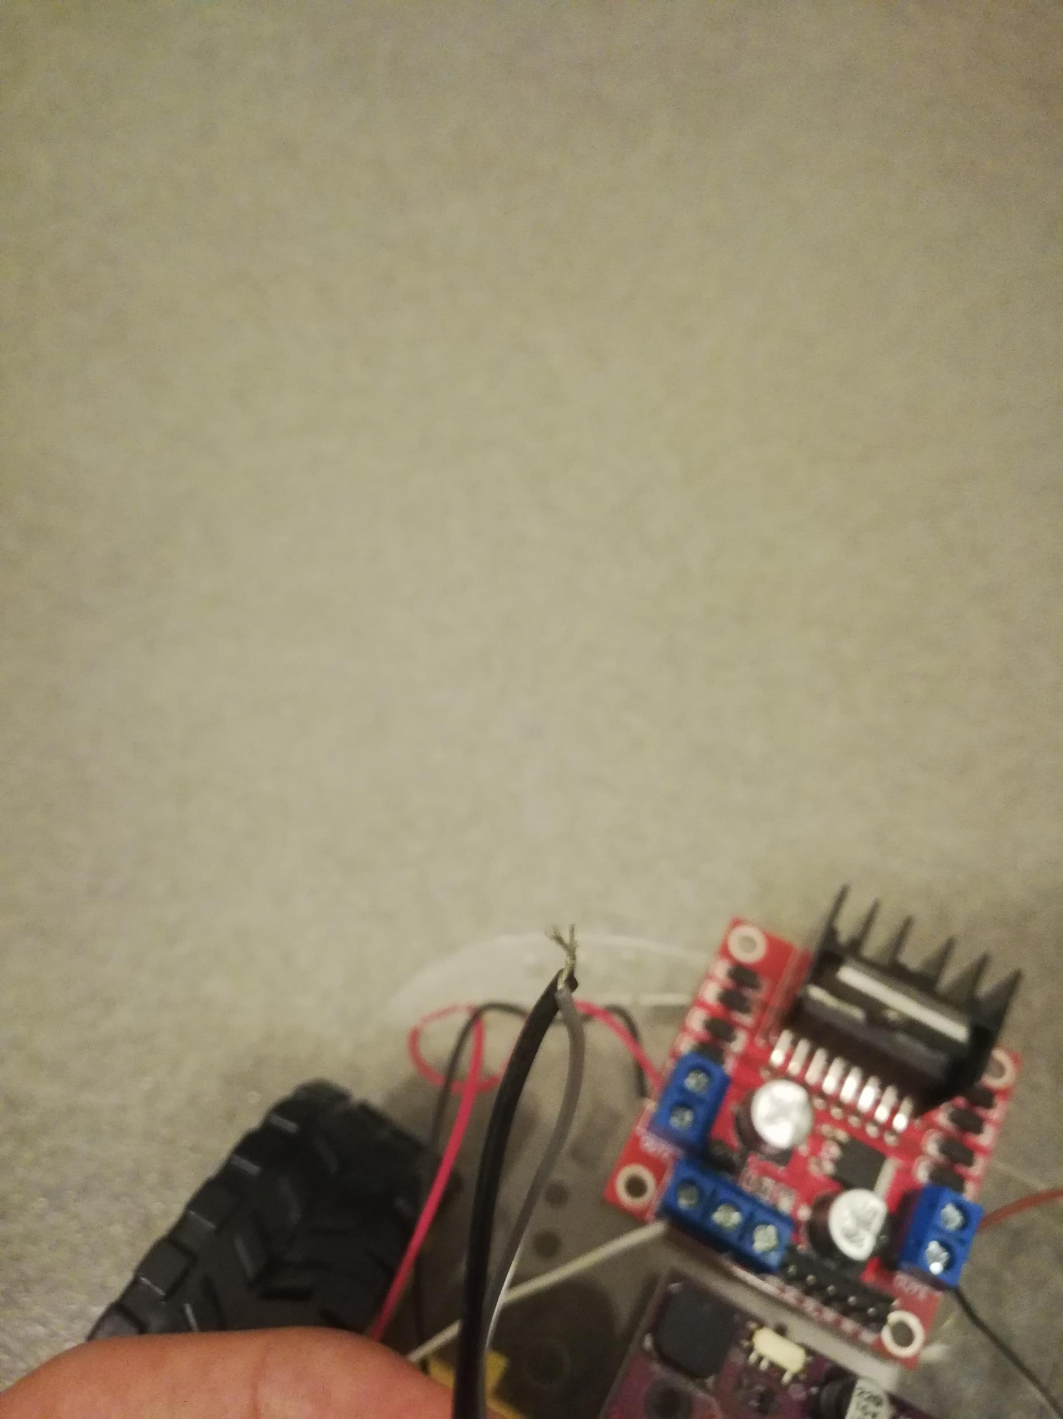
Wiring (Maker uno)
Step 7:
Get a grey wire and twist it together with the battery holder’s black wire.
You may request assistance for cutting the wire longer from our committee members. Just abuse them.

Slide 10
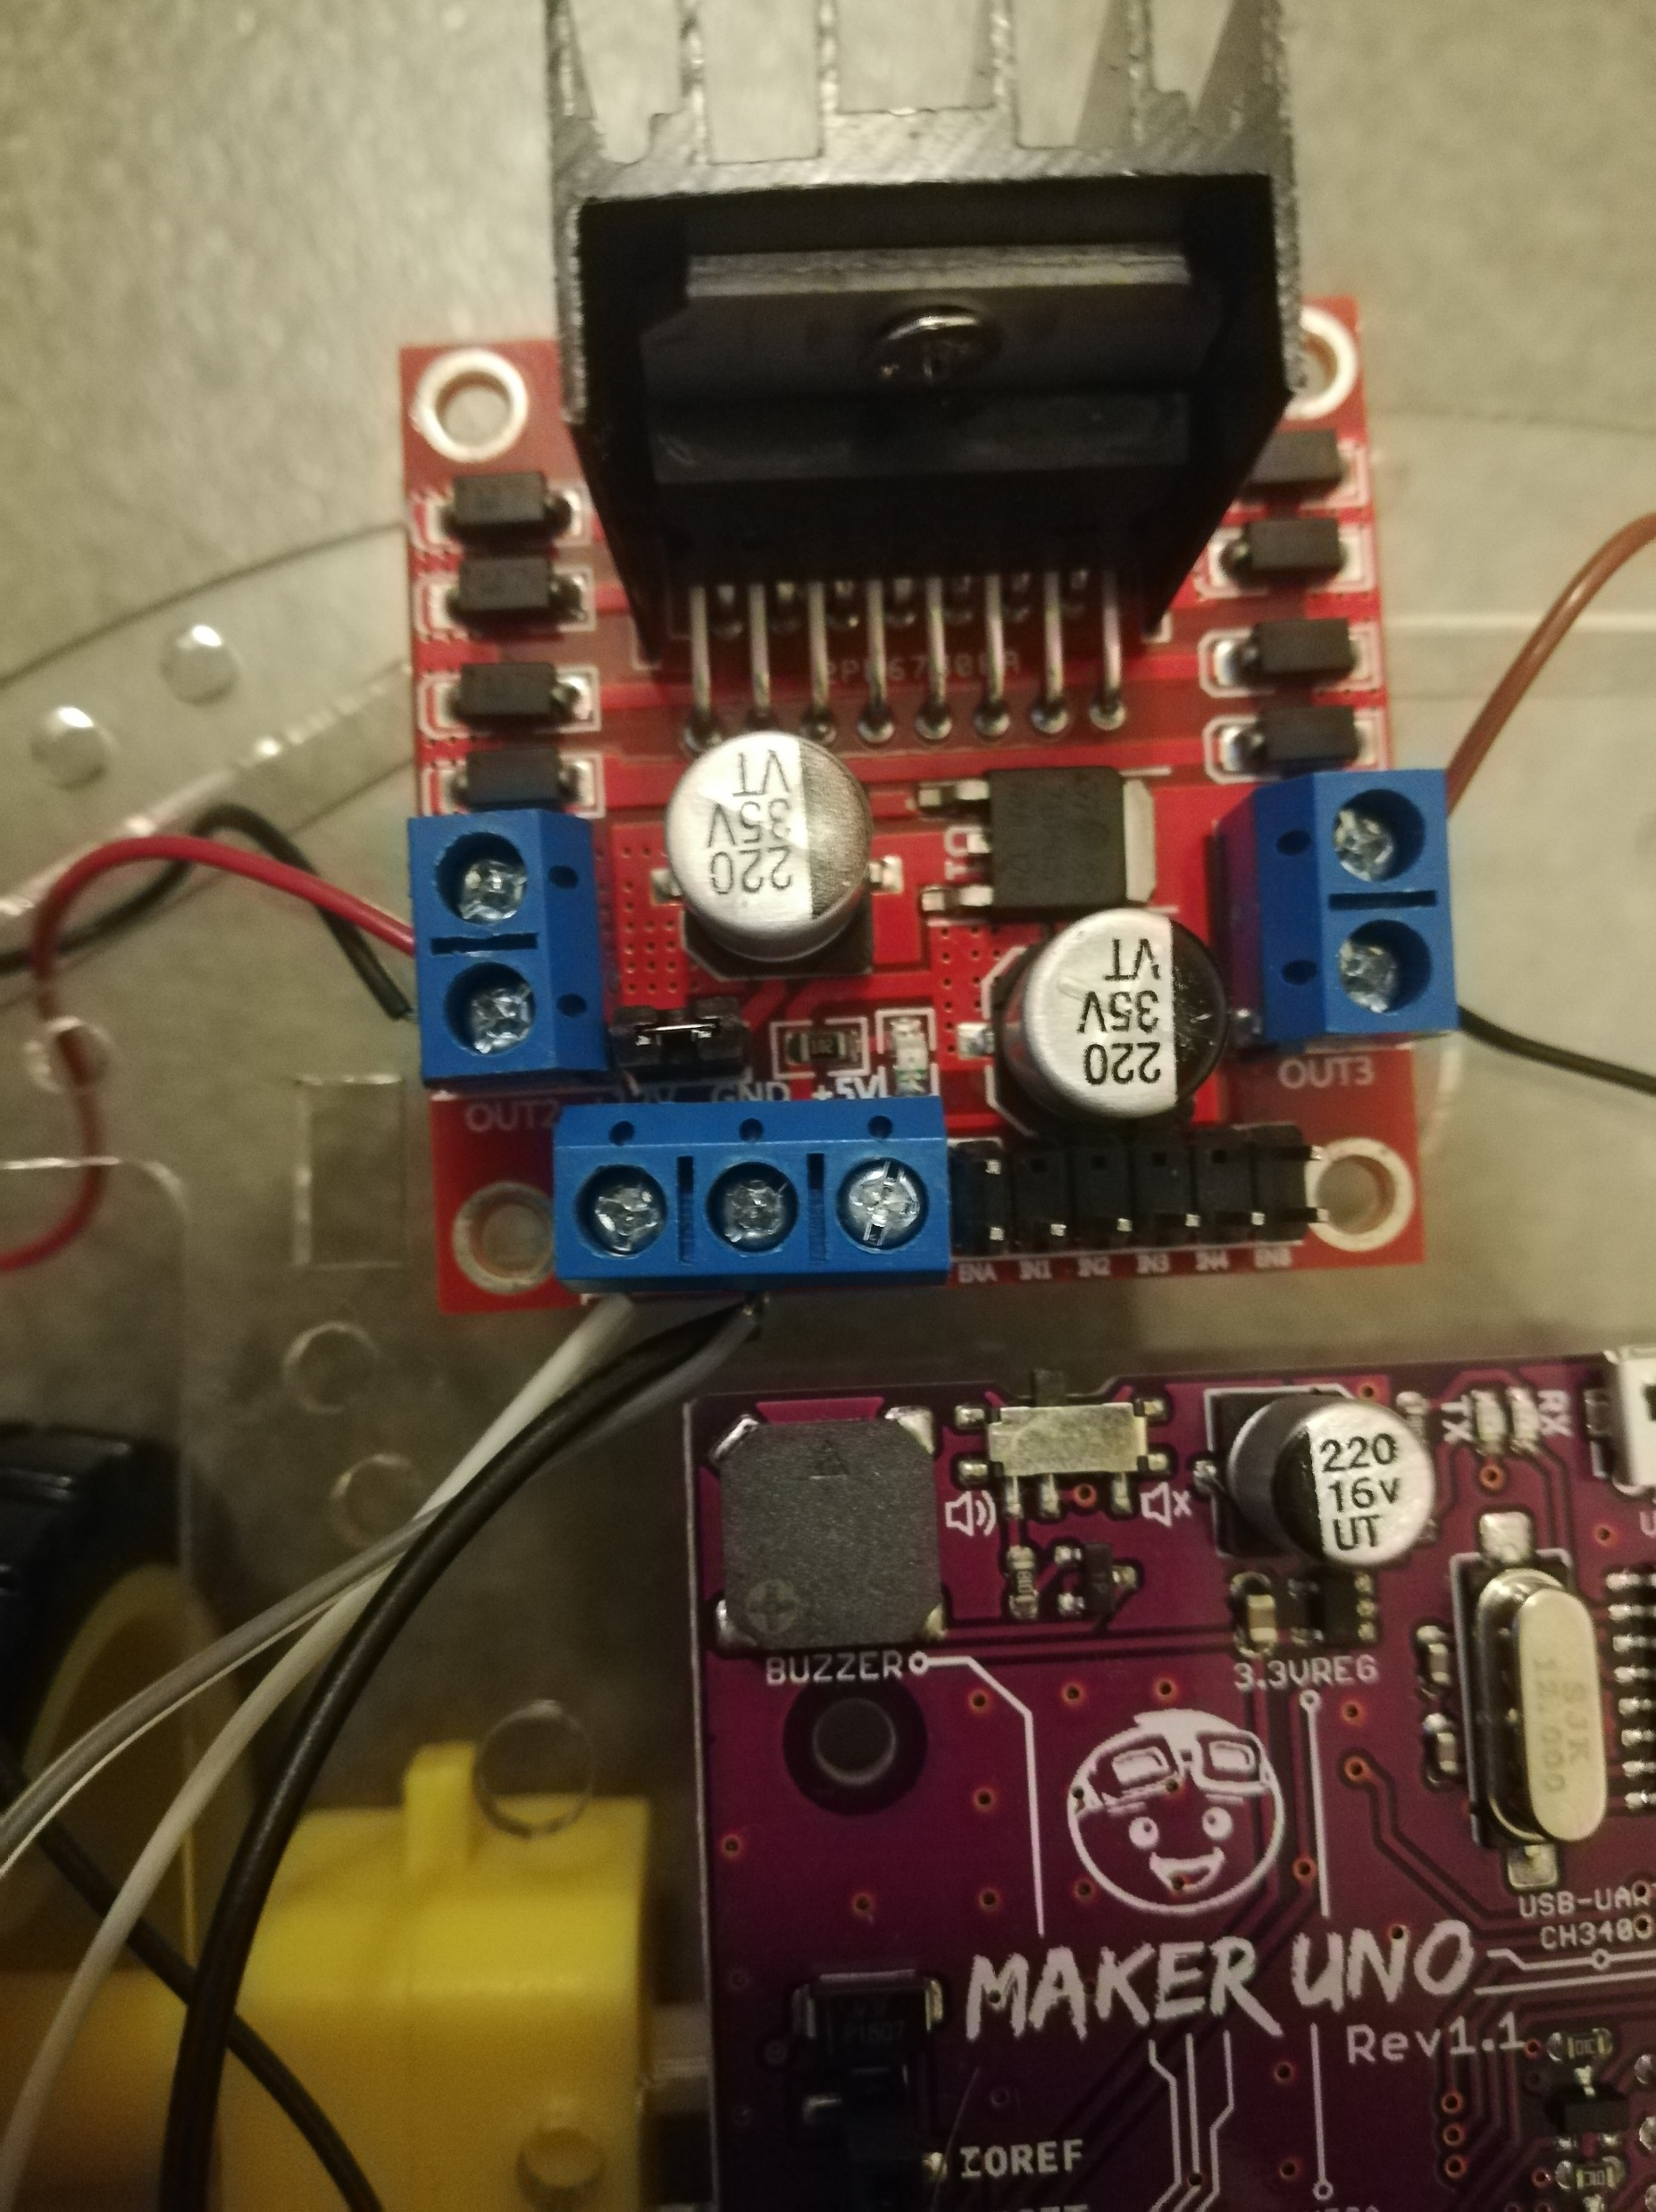
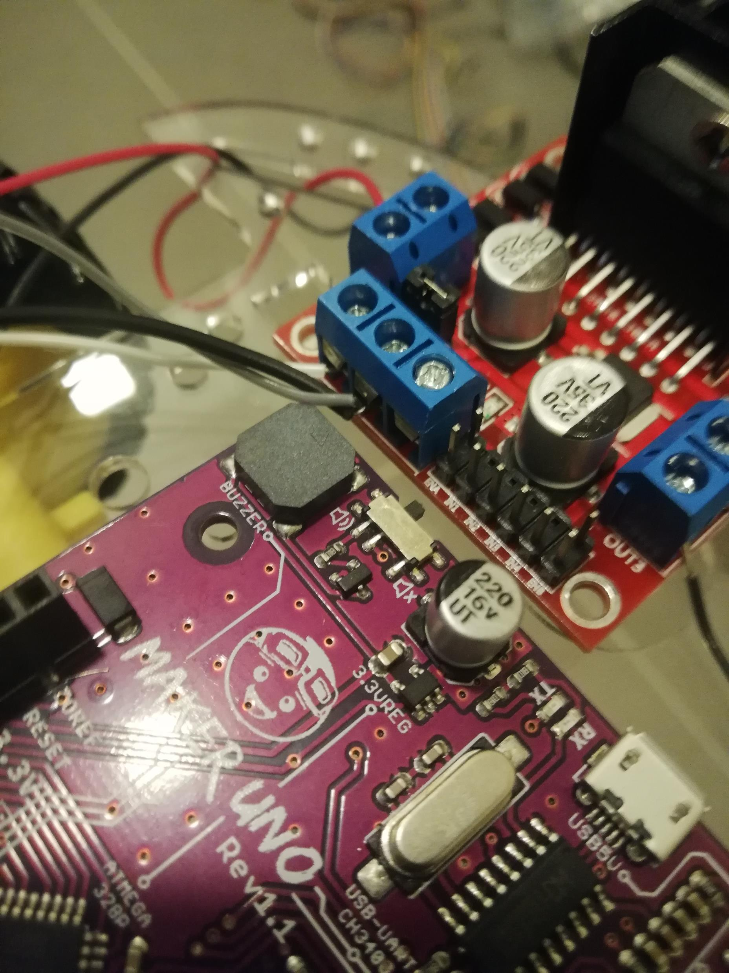
Wiring (Maker UNo)
Step 8:
Connect the twin wires into the middle terminal of the front part motor driver.
The terminal should indicate a GND sign written on the board.

Slide 11
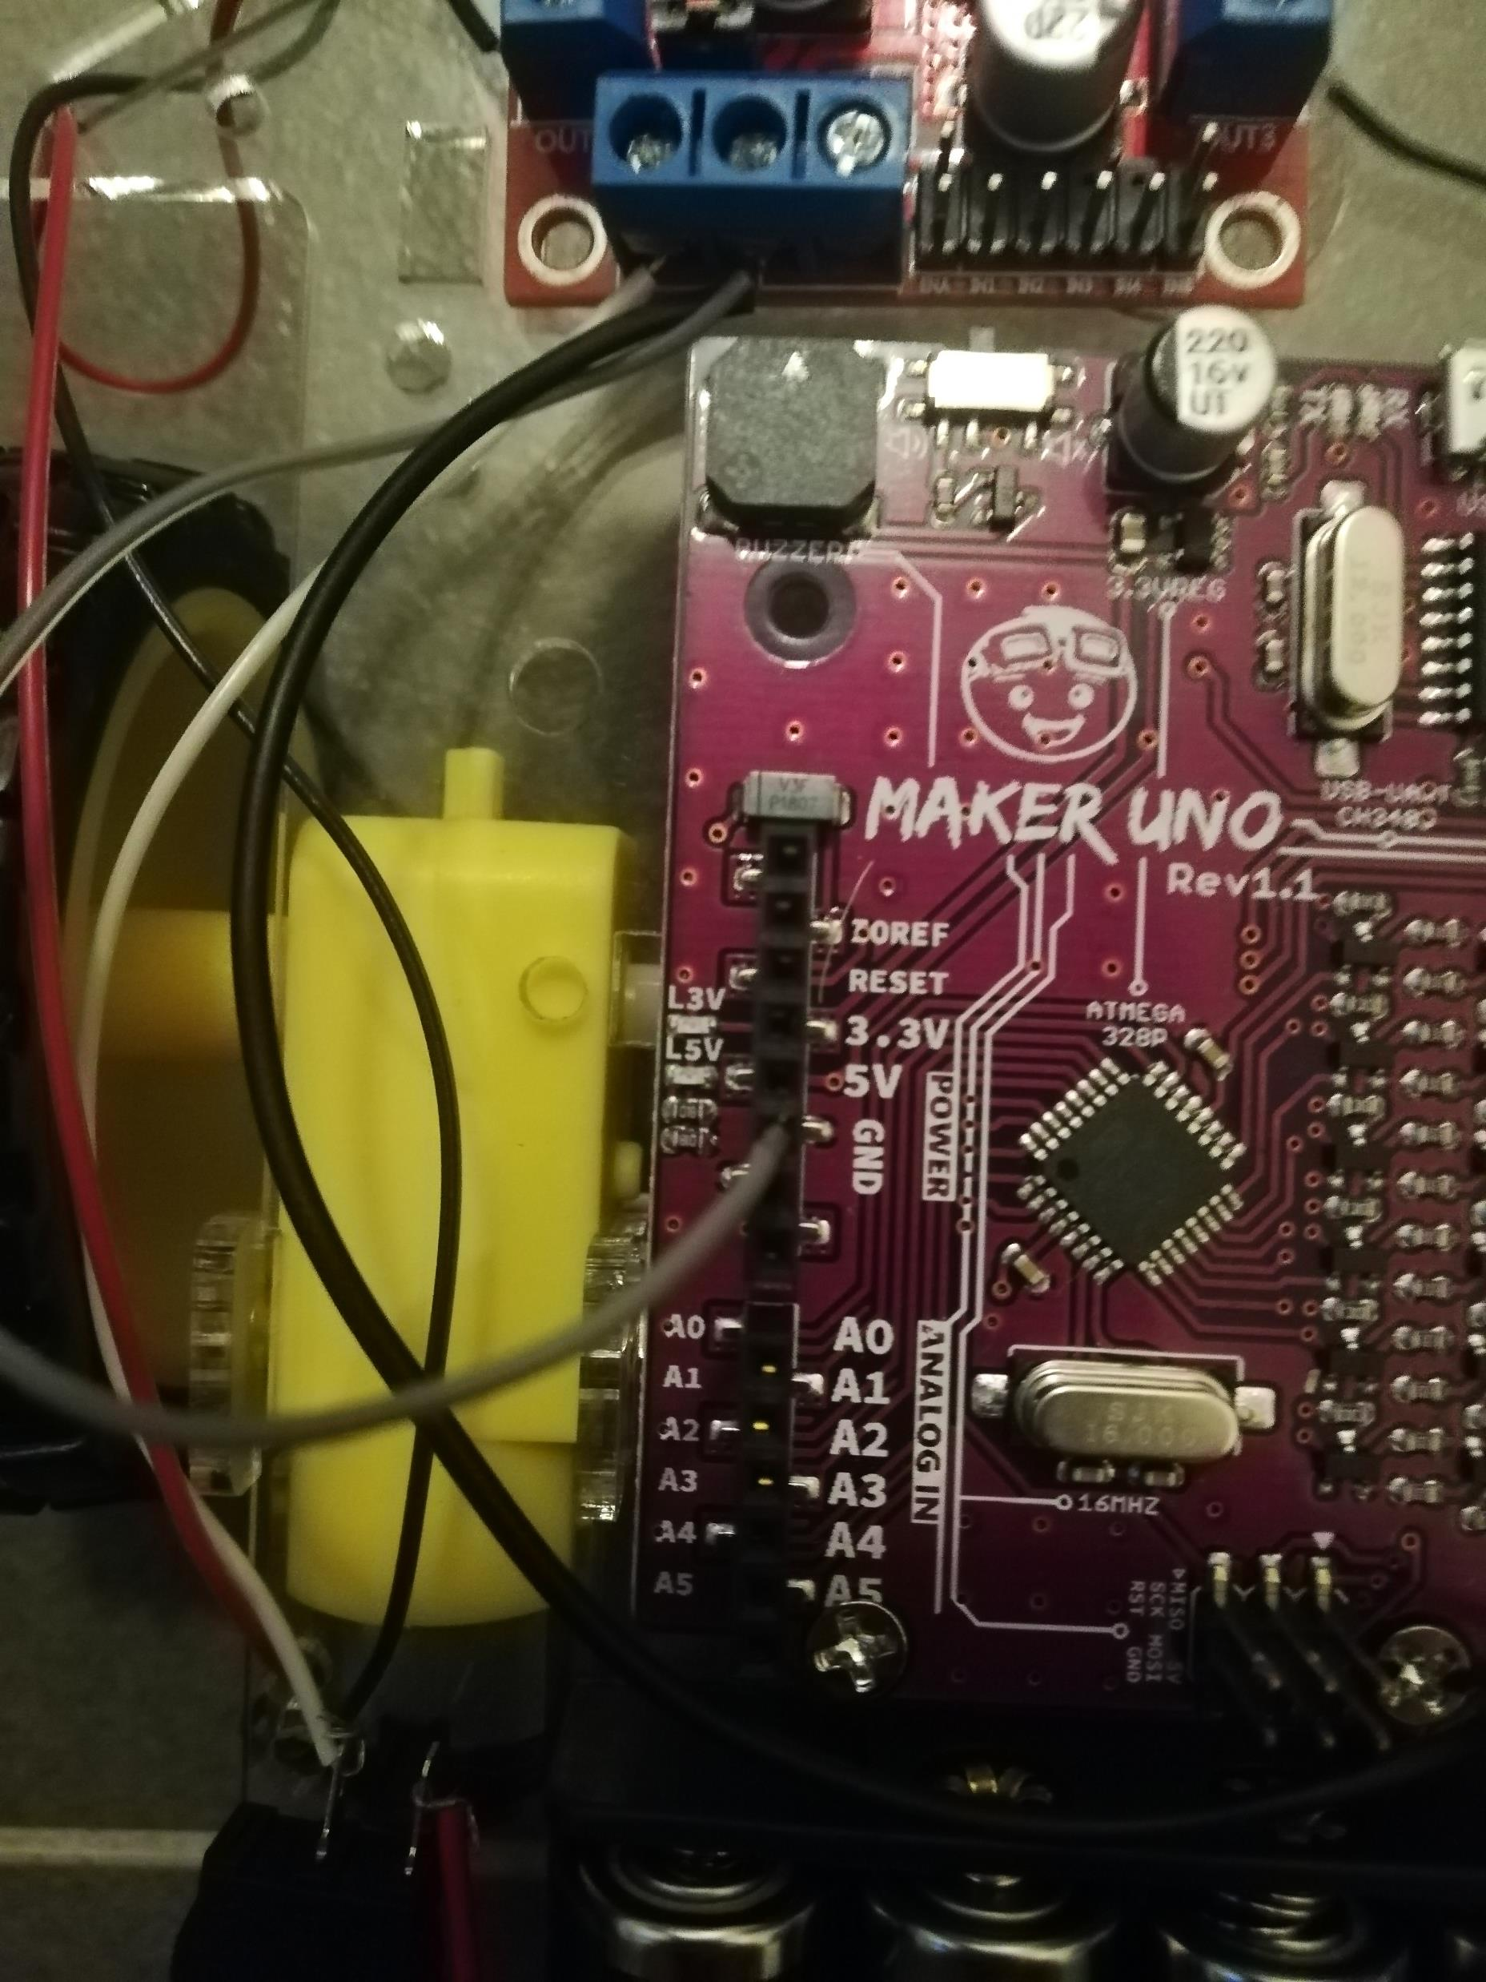
Wiring (Maker UNo)
Step 9:
Connect the grey wire the GND of Maker Uno.
Please ask for assistance if you are unsure of the connections, I don’t pay these committee members for nothing. Jk I cant even feed myself.

Slide 12
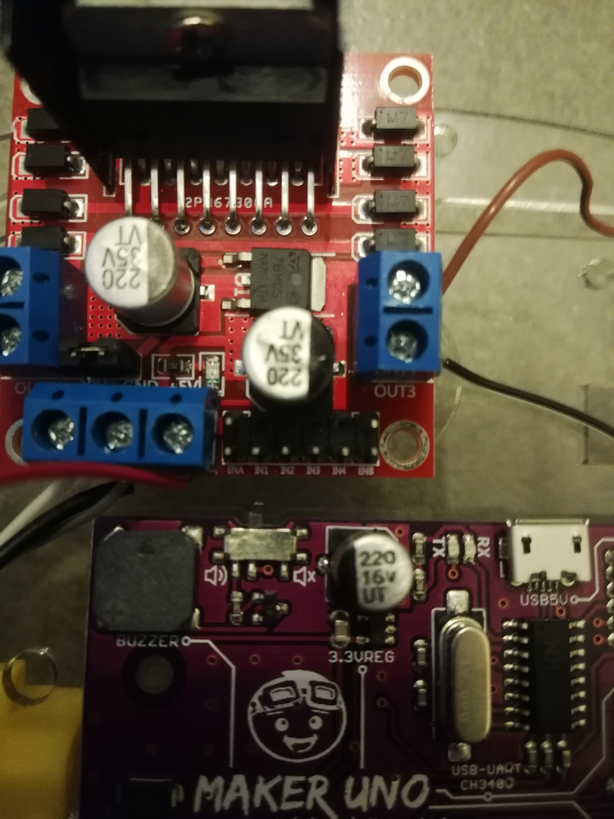
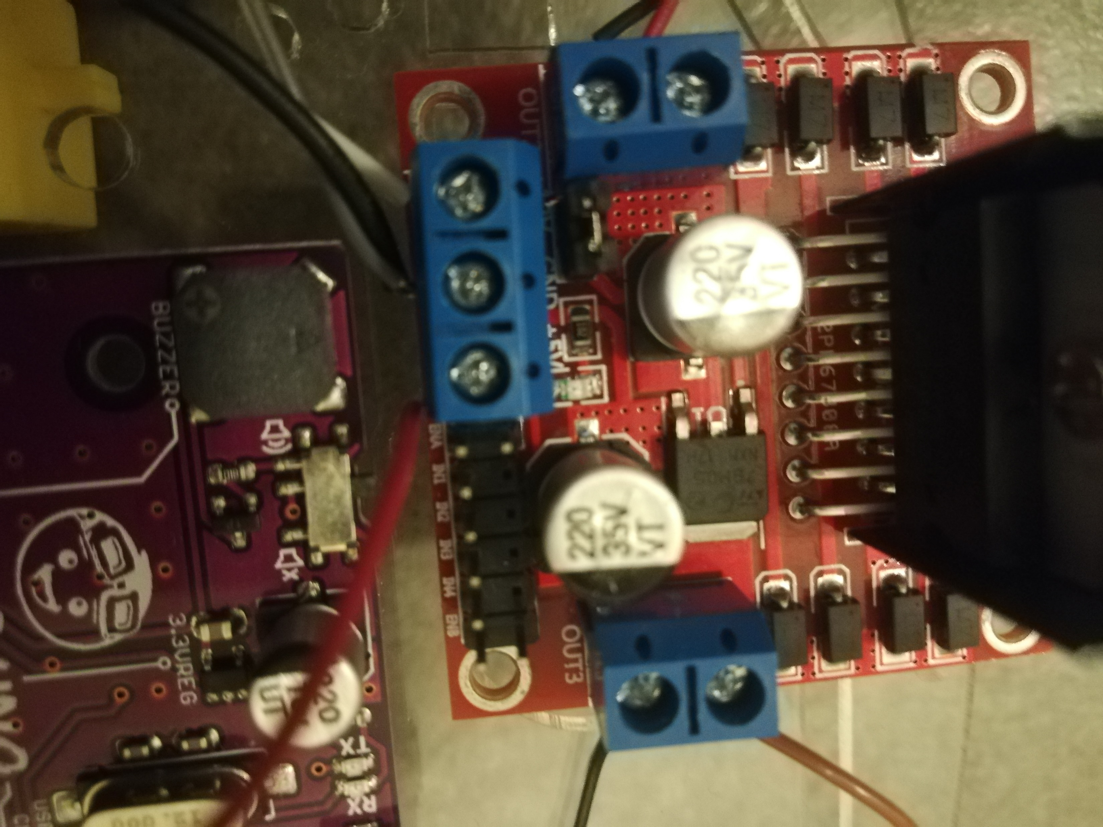
Wiring (Maker UNo)
Step 10:
Get a new red wire, and connect the right terminal on the front part motor driver.
The terminal should indicate a +5V sign written on the board.

Slide 13
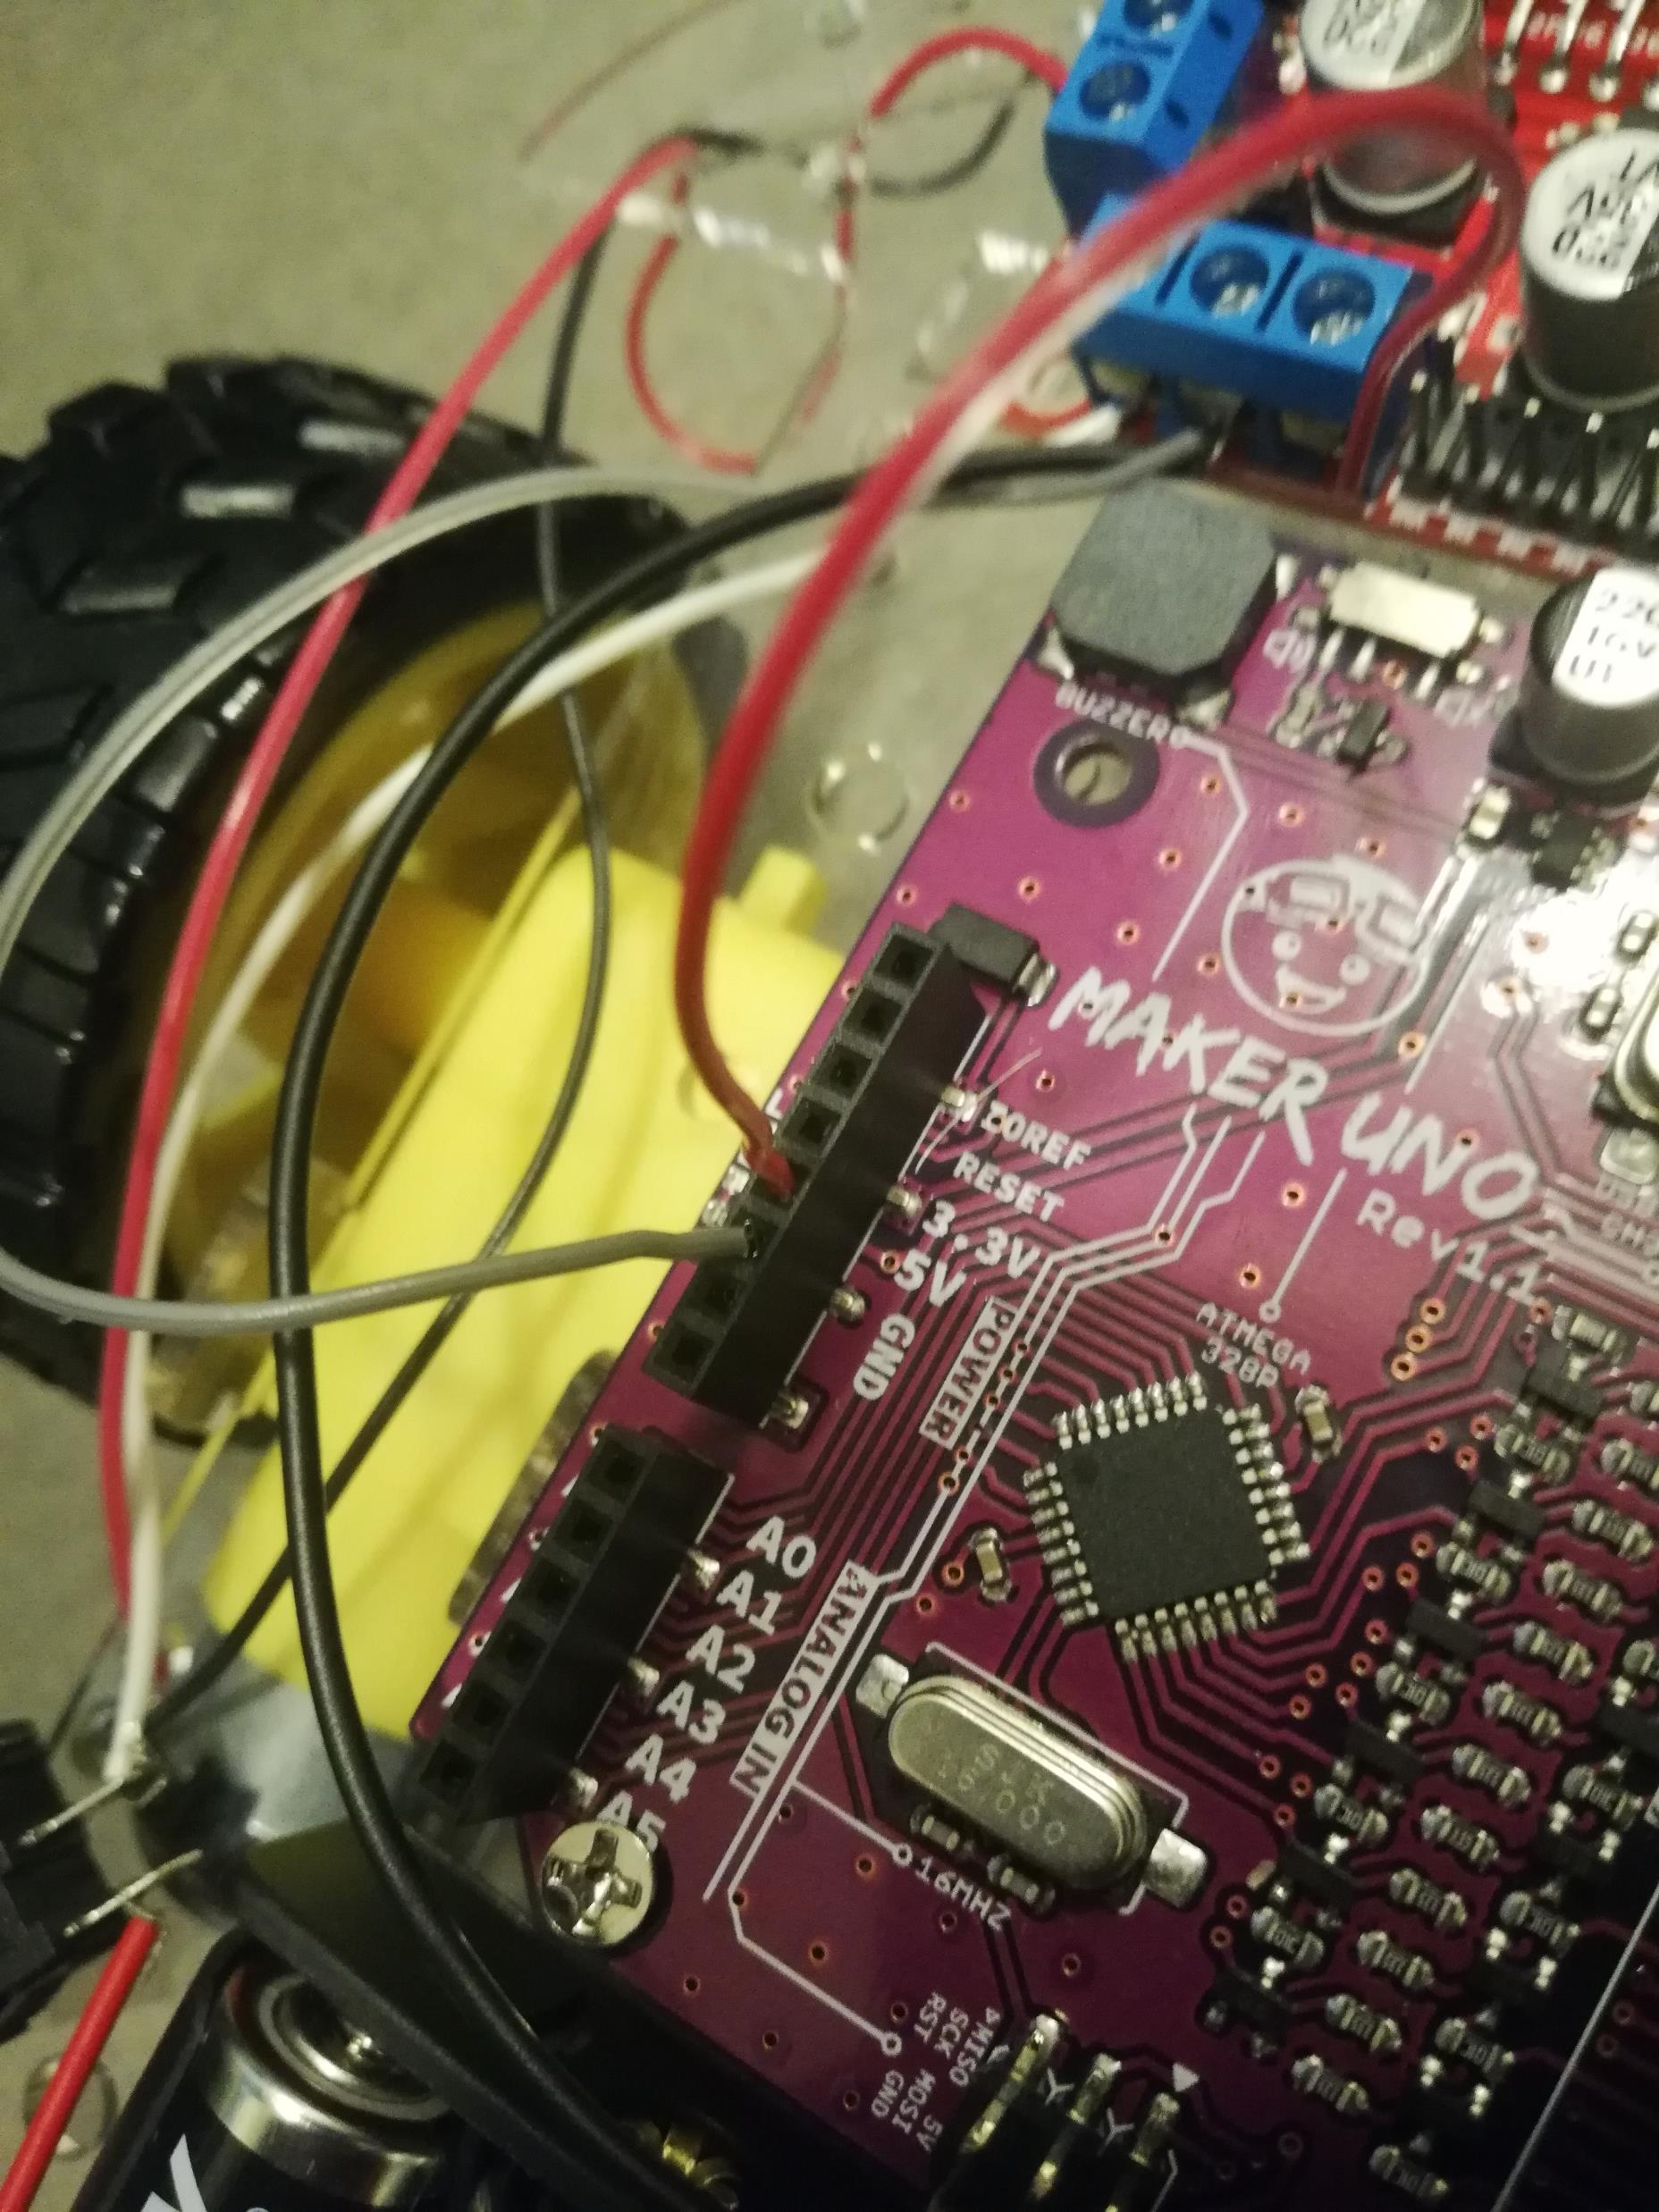
Wiring (Maker UNo)
Step 11:
Connect the red wire to the 5V pin of Maker Uno.
Please ask for assistance if you are unsure of the connections, I don’t pay these committee members for nothing. Jk I cant even feed myself.

Slide 14
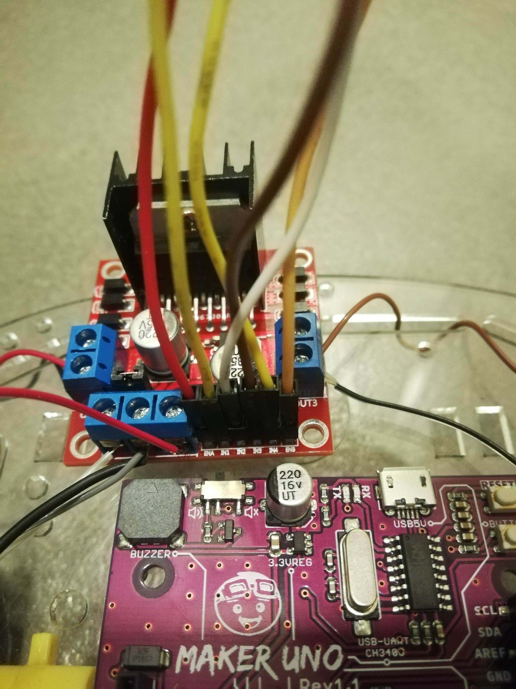
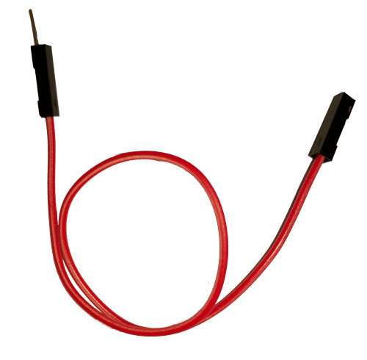
Wiring (Motor driver)
Step 12:
Get 6 male to female wires, and connect them to the motor driver pins ENA, IN1,IN2,IN3,1N4,ENB. Remove the caps for ENA and ENB and please don’t loose them.
Male and Female *wink*

Slide 15
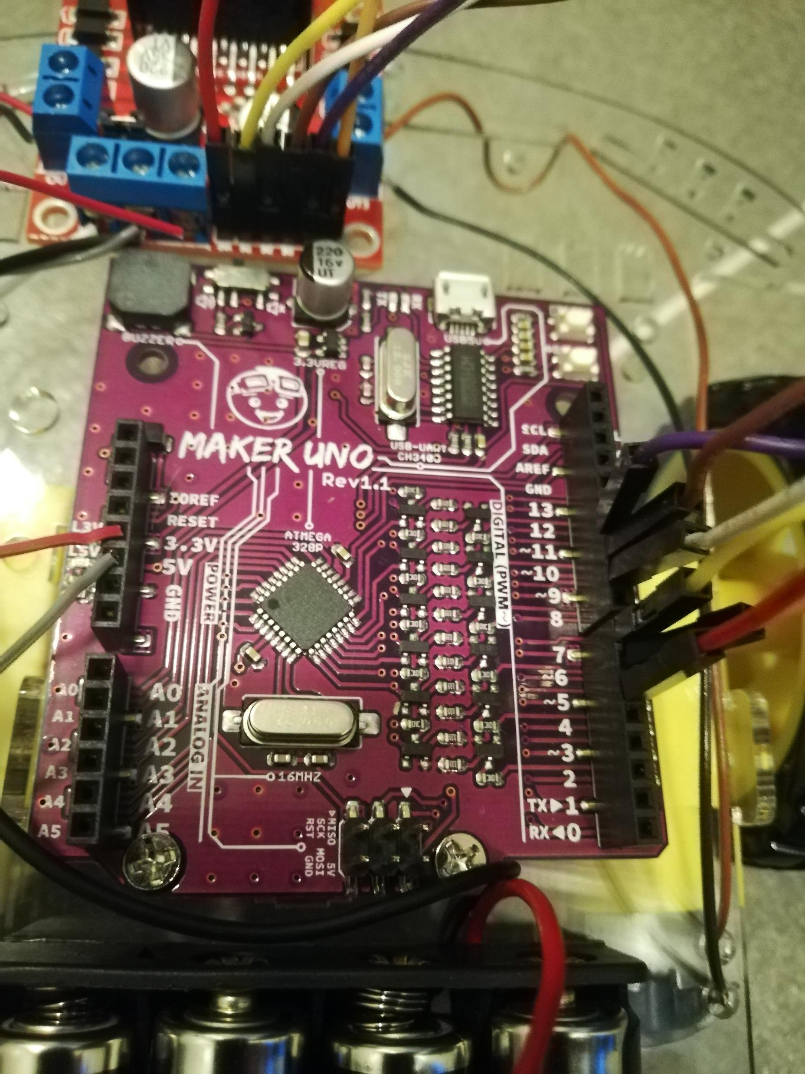
Wiring (motor driver)
Step 13:
Follow the connection instructions below:
ENA (1st wire) -> PIN 5
IN1 (2nd wire) -> PIN 7
IN2 (3rd wire) -> PIN 9
IN3 (4th wire) -> PIN 10
IN4 (5th wire) -> PIN 11
ENB (last wire) -> PIN 6
Please abuse our committee members again

Slide 16
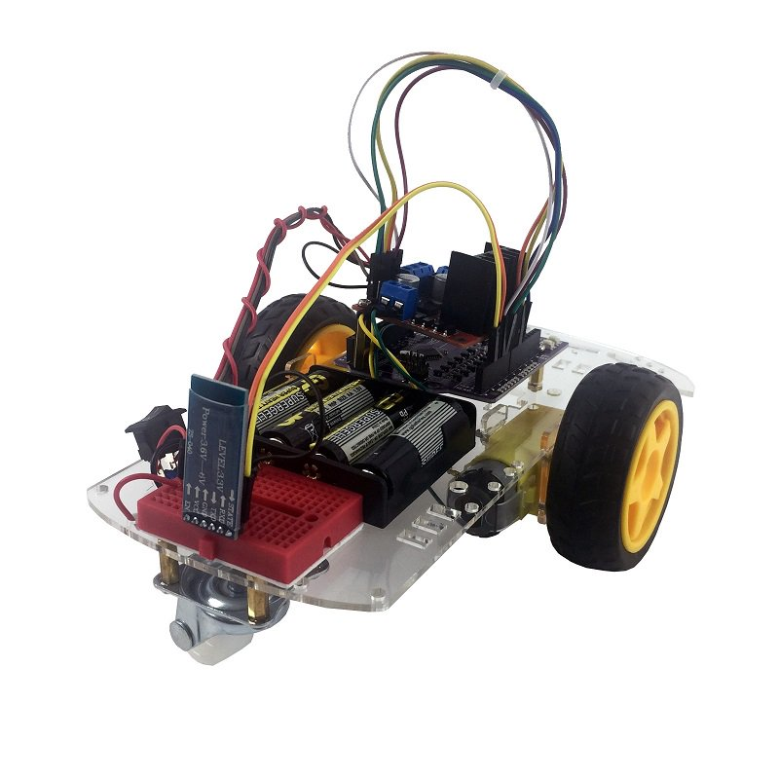
Test your robot with GitHub code! (Please ask for confirmation of wiring before proceeding)
Go to Arduino 2nd Workshop Folder -> MotorTest -> MotorTest.ino and upload to the Maker Uno.
Turn on the power switch then press the button below the reset button on the Maker Uno.
Your motor will begin to spin. Press again and notice the wheel direction changes.
Check if the sequence is correct: Stop, Forward, Reverse, TurnRight, TurnLeft, Brake, Stop. Note that the forward direction is referencing to the Motor Driver as the head.
If the directions are wrong, consider switching wire terminals (OUT1 AND OUT2 swap etc)

Slide 17


We done k.

